Slide 1
Note on Capacities
1000 (1024 = 2^10 ) bytes 1 Kilobyte 1KB
1,000,000 bytes (1024 x1024) 1 Megabyte 1MB
1,000,000,000 bytes (2^30) 1 Gigabyte 1GB
Terabyte - a thousand billion bytes (that is, a thousand gigabytes). More precisely, 2^40 bytes 1TB
Petabyte is a measure of memory or storage capacity and is 2 ^ 50 bytes or, in decimal, approximately a thousand terabytes 1PB
Next up: Exa (2^60), Zetta (2^70) and Yotta (2^80)
Note the use of Capital letters for GB, etc

Slide 2
Numbers
However, when we talk about transmission speeds, we generally refer to( decimal) bits/sec (rather than Bytes)
1kbs line transmits at 1000 bits/sec
1mbs line runs at 1,000,000 bits/sec
Disk sizes are often misleading: a manufacturer’s 100GB HDD may actually only have 10^9 rather than 2^30 Byte capacity. Not only that, they may include the intersector gap as part of the ‘capacity’!

Slide 3
Computer Organisation 1
Source Data Automation and
Radio Frequency ID - RFID

Slide 4
Source Data Automation
Data entered into a computer without key entry
Two types of scanner used: Contact and Laser
Both types depend on bouncing a light beam off an image, then measuring the reflected light to interpret the image
Contact scanners must make contact (with the paper); laser scanners can read data passed near the scanning area

Slide 5
Source Data Automation
Handheld Scanners (wands) use either contact or laser technology – libraries, retail
Stationary label scanners (all Laser) – same applications
Document Scanners read documents of varied sizes – envelopes, turnaround documents

Slide 6
Optical Input – Magnetic Ink Character Recognition (MICR)
Used by banks to sort cheques, which are sent by branches to a central clearing house
Recognisable by people and MICR readers
MICR line printing is accurate to better than 1 part in 1,000

Slide 7

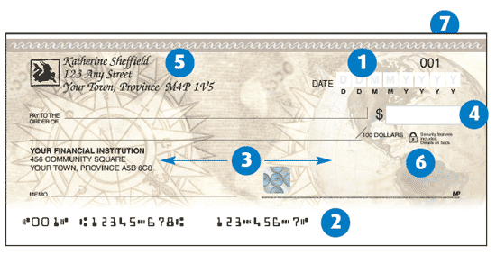
Cheque number, Customer Account No., Bank Sort Code

Slide 8
Optical Data Capture:
Optical Mark Recognition (OMR)

Slide 9
Definition/Concept of OMR
A technology that allows an input device (e.g. imaging scanner) to read hand-drawn marks such as small circles or rectangles on specially designed paper.
  Often used for test, survey, or questionnaire answer sheets.

Slide 10
Definition/Concept of OMR
The process of capturing data by contrasting reflectivity at predetermined positions on a page
  Sometimes Referred to as Optical Mark Reader

Slide 11
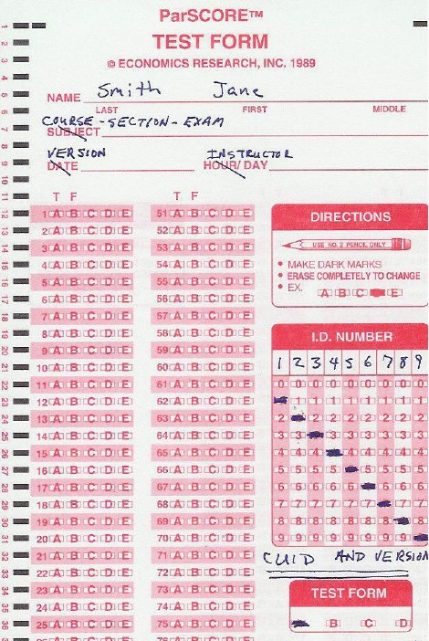
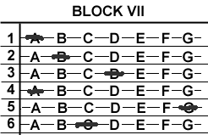
OMR Forms
“Reads” mark information in the form of numbers or letters and put it into the computer.
The marks have to be precisely located

Slide 12


OMR Forms
  An OMR works with a specialized document and contains timing tracks along one edge of the form to indicate scanner where to read for marks which look like black boxes on the top or bottom of a form.

Slide 13
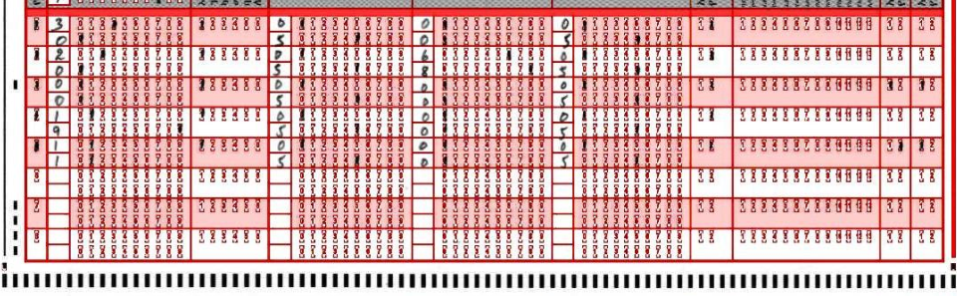
OMR Forms
Timing tracks indicate where to read for marks and indicate where to clip images

Slide 14
OMR Scanners and Software
Have specifically placed LEDs (Light-emitting diodes)
LEDs sense marks in certain columns once a timing track is detected
Software interprets the output from the scan and translates it to the desired format (e.g. ASCII)

Slide 15
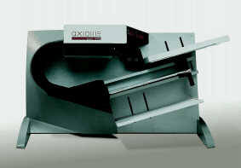
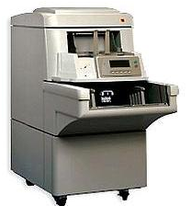
OMR Scanners and Software
Scanner Characteristics:
  ~85 pages per minute (e.g Axiome AXM 980 or Kodak 3000 Series)
  ~130 pages per minute (e.g. Kodak i 830)
Software Characteristics:
  performing specific imaging functions such as:
  - image acquisition,
  - file conversion,
  - data extraction, and
  - file read/write commands (e.g. ISIS)

Slide 16
OMR Storage Characteristics
Storage
  Barcodes: Identification of forms
  OMR Marks and Barcodes are read and moved directly into a database management system (e.g. SQL) then to a census database
  Images are not normally scanned and stored
  However, The capability of saving the scanned image is there!

Slide 17
OMR Storage Characteristics
Storage of Scanned Images (Recent Mainstream Capability)
  Increasingly critical for validating results
  Images can be used for correcting poorly filled out forms
  Images can be used for validating results
  Comprehensive image database of forms

Slide 18
OMR Accuracy
Accuracy
  To achieve high accuracy, well structured design and good quality printing of these forms is critical.
  If the timing track and the bubbles on the form are not in the exact columns where the LEDs in the read head can detect them (Skew), there is no way for the scanner to read the marks (Float)
    This is referred to as skew and float

Slide 19
OMR Advantages
OMR is a data collection technology that does not require a recognition engine. Therefore:
  It is fast, using minimum processing power to process forms
  Costs are predictable and defined
  OMR capture speeds range around 4000 forms per hr

Slide 20
OMR Disadvantages
Disadvantages
  OMR cannot recognize hand-printed or machine-printed characters.
  With OMR, images of forms are not captured by scanners so electronic retrieval is not possible.
  Tick boxes may not be suitable for all types of questions

Slide 21
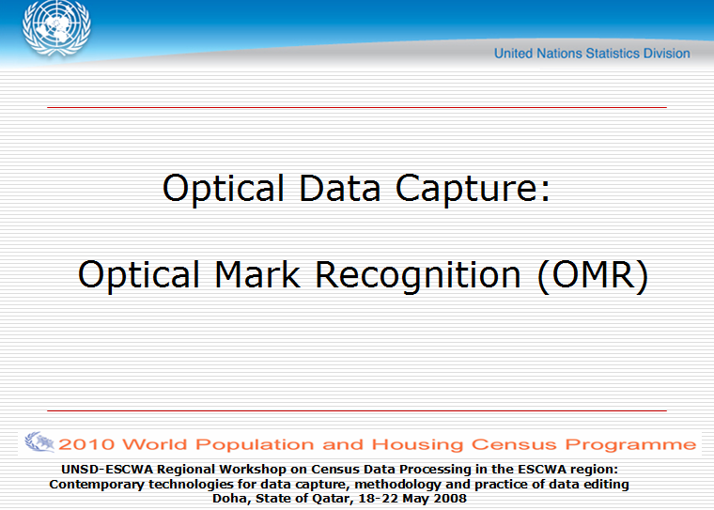
OMR Stuff Copied from following:

Slide 22
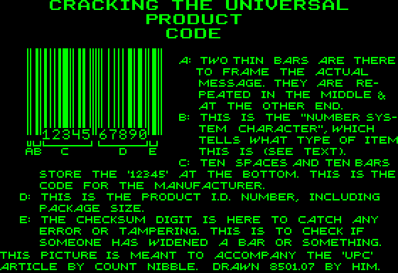
UPC – Universal Product Code

Slide 23
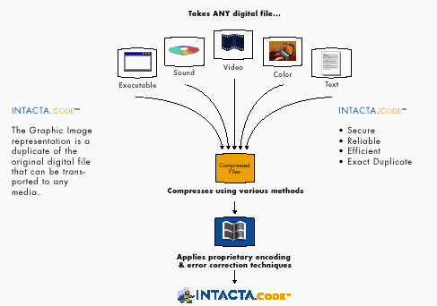
Intacta Code – super bar code

Slide 24
Intactatm
Can be used to distribute photos, MP3 files, game software demos through newspaper or magazines
Readers scan the bar code and download the code into their computers using ordinary scanner and Intacta software to decode the dot pattern

Slide 25
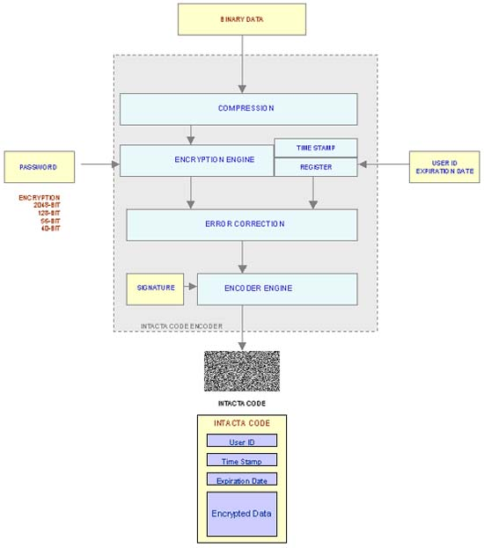

Slide 26
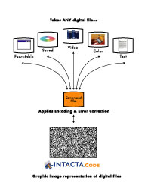
INTACTA Image

Slide 27
Magnetic Stripe and Stored Value Smart Card
Magnetic stripe cards can’t be read visually, and can hold much more data per sq inch than print or bar codes
eg bank cards, employee cards, student cards
Smart cards look similar but have up to 64KB of storage and processing capability
Stored value cards contain money equivalents for special transactions eg London Transport Oyster card

Slide 28
Where is RFID used?
‘RFID is in use all around us. If you have ever chipped your pet with an ID tag, used EZPass through a toll booth, or paid for gas using SpeedPass, you've used RFID.’
‘Unlike bar-code technology, RFID technology does not require contact or line of sight for communication. RFID data can be read through the human body, clothing and non-metallic materials.’
Notes:
From http://www.aimglobal.org/technologies/RFID/what_is_rfid.asp
Some notes in this talk have also been taken from Tanenbaum, A. Structured Computer Organisation, 2006

Slide 29
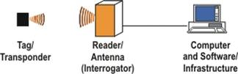
Basic RFID technology
The antenna emits radio signals to activate the tag.
Antennae come in a variety of shapes and sizes; they can be built into a door frame to receive tag data from persons or things passing through the door, or mounted on a toll booth to monitor traffic.

Slide 30
Transponder
A transponder is a wireless communications, monitoring, or control device that picks up and automatically responds to an incoming signal. The term is a contraction of the words transmitter and responder. Transponders can be either passive or active.

Slide 31
RFIDs
The reader emits radio waves in ranges of anywhere from one inch to 100 feet or more, depending upon its power output and the radio frequency used.
When an RFID tag passes through the signal, it detects the reader's activation signal. The reader decodes the data encoded in the tag's integrated circuit (silicon chip) and the data is passed to the host computer for processing.

Slide 32
RFIDs
RFID tags come in a wide variety of shapes and sizes. Animal tracking tags, inserted beneath the skin, can be as small as a pencil lead in diameter and one-half inch in length. Tags can be screw-shaped to identify trees or wooden items, or credit-card shaped for use in access applications.

Slide 33
ACTIVE or Passive RFIDs
Active RFID tags are powered by an internal battery and are typically read/write
An active tag's memory size varies according to application requirements; some operate with up to 1MB of memory.
In a typical read/write RFID work-in-process system, a tag might give a machine a set of instructions, and the machine would then report its performance to the tag. This encoded data would then become part of the tagged part's history.
The battery-supplied power of an active tag generally gives it a longer read range. The trade off is greater size, greater cost, and a limited life (may be a maximum of 10 years, depending upon operating temperatures and battery type)
Active examples: Oyster Card, eFLow tag on M50

Slide 34
Active or PASSIVE RFIDs
Passive RFID tags operate without a separate external power source and obtain operating power from the reader’s radio signal long enough to transmit their number back to the antenna.
Passive tags are much lighter than active tags (0.5mm on edge with a tiny radio transponder and a built in unmodifiable unique 128-bit number), cheaper, and offer a virtually unlimited lifetime. The trade off is that they have shorter read ranges than active tags and require a higher-powered reader.

Slide 35
Frequencies in RFIDs
Low-frequency (30 KHz to 500 KHz) systems have short reading ranges
High-frequency (850 MHz to 950 MHz and 2.4 GHz to 2.5 GHz) systems, offer long read ranges (greater than 90 feet) and high reading speeds, are used for such applications as railroad car tracking and automated toll collection.

Slide 36
Advantages
A noncontact, non-line-of-sight technology. Tags can be read through a variety of substances such as snow, fog, ice, paint, grime, and other challenging conditions, where barcodes or other optically read technologies would be useless.
The read/write capability of an active RFID system is also a significant advantage in interactive applications such as work-in-process or maintenance tracking.
BUT, costlier than barcode

Slide 37
Advantages
Passive RFIDs with permanent 128-bit numbers create a situation where it is possible to have a unique code attached to an item.
For example, the European Central Bank has decided to put RFID chips into all banknotes in future. This will cut down on counterfeiting, ransoms, bank robbery and money laundering
All supermarket items can have a unique number, not just a bar code, and this will allow cheaper trapping of faulty batches

